Slide 1
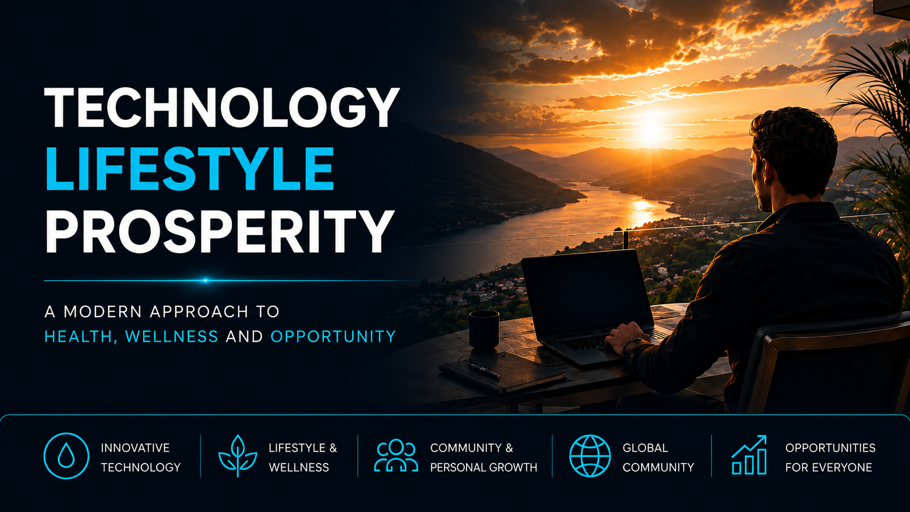
Notes:
"Thank you for being here.
Today, I’d like to share why thousands of people around the world have chosen a business
that combines cutting-edge technology, wellness, and a modern approach to creating opportunities

Slide 2


Slide 3
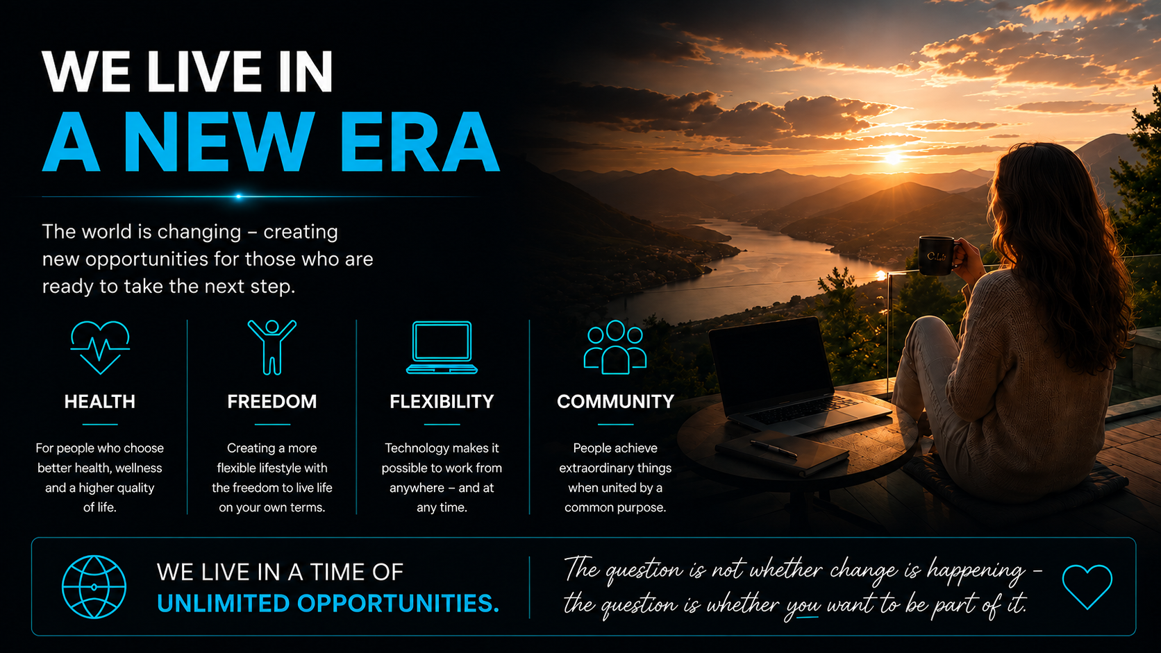
Notes:
We Are Living in a New Era
The world is changing faster than ever before.
The way we work, live, shop, and create opportunities looks very different today than it did just a few years ago.
We are living in a time when more people than ever are prioritizing their health and well-being. We no longer simply want to live longer — we want to live better.
At the same time, many people are seeking greater freedom. Freedom to decide how they spend their time, how they earn their income, and the lifestyle they want to create.
Technology has made it possible to work, communicate, and create value across borders. This provides a level of flexibility that previous generations could only dream of.
Perhaps most importantly, people today are searching for community. We want meaningful relationships, a sense of purpose, and to be part of something bigger than ourselves.
That is why this opportunity is about more than products or business.
It is about people.

Slide 4
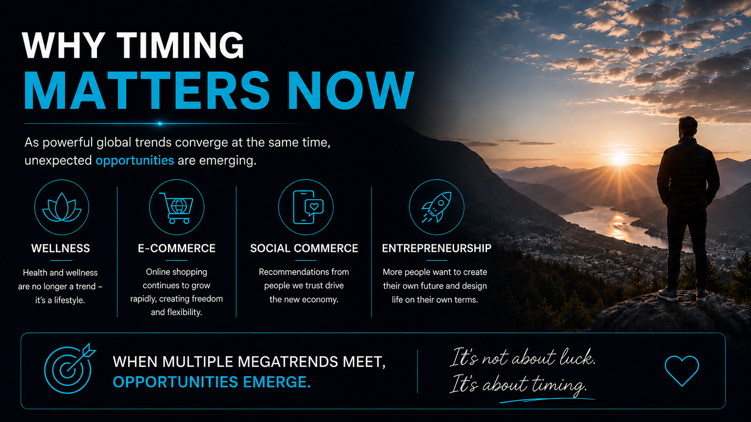
Notes:
Why Timing Matters
“When we look at the biggest success stories in business and innovation, it is rarely just about the right product or the right idea.
It is often about timing.
Right now, we are seeing several powerful trends converge at the same time.
More people than ever are prioritizing health. People want to live longer and better lives, with greater energy and vitality.
At the same time, e-commerce continues to grow. Consumers increasingly prefer shopping online, driven by convenience and accessibility.
At the same time, we are witnessing the rise of social commerce, where people trust recommendations from people they know more than traditional advertising.
And finally, more people than ever are looking for entrepreneurship, freedom, and flexibility, creating a growing demand for new ways of working and living.
When these megatrends come together, opportunities are created.
Not because the company is better than everyone else, but because it is the right company, at the right time, in the right market.
And timing is often the difference between an opportunity and a success story.

Slide 5
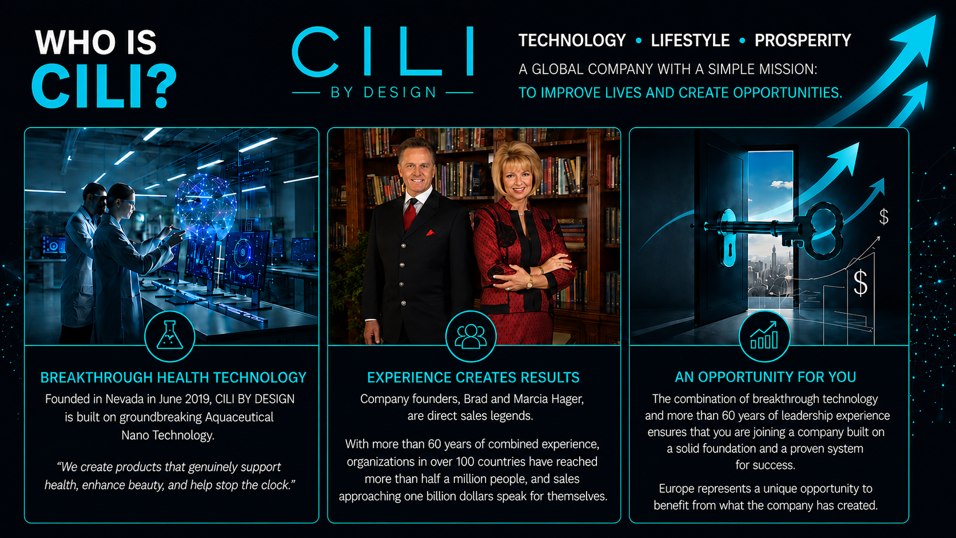
Notes:
So, who is CILI by Design?
CILI is a global wellness company built on three core pillars: Technology, Lifestyle, and Prosperity.
At its foundation, the company combines groundbreaking Aquaceutical® Technology with innovative wellness solutions designed to help the body absorb nutrients more efficiently, supporting health and well-being at the cellular level.
Within the Lifestyle pillar, the company focuses on health, personal development, and creating meaningful communities. We believe that health, relationships, and mental well-being are the foundation of a fulfilling life.
Within the Prosperity pillar, CILI provides people with the opportunity to generate additional income, develop leadership skills, and build a business on a solid foundation—while helping others improve their quality of life.
For me, this is about more than products.
It is about creating opportunities, empowering people, and making a positive difference—in both personal and financial ways.

Slide 6
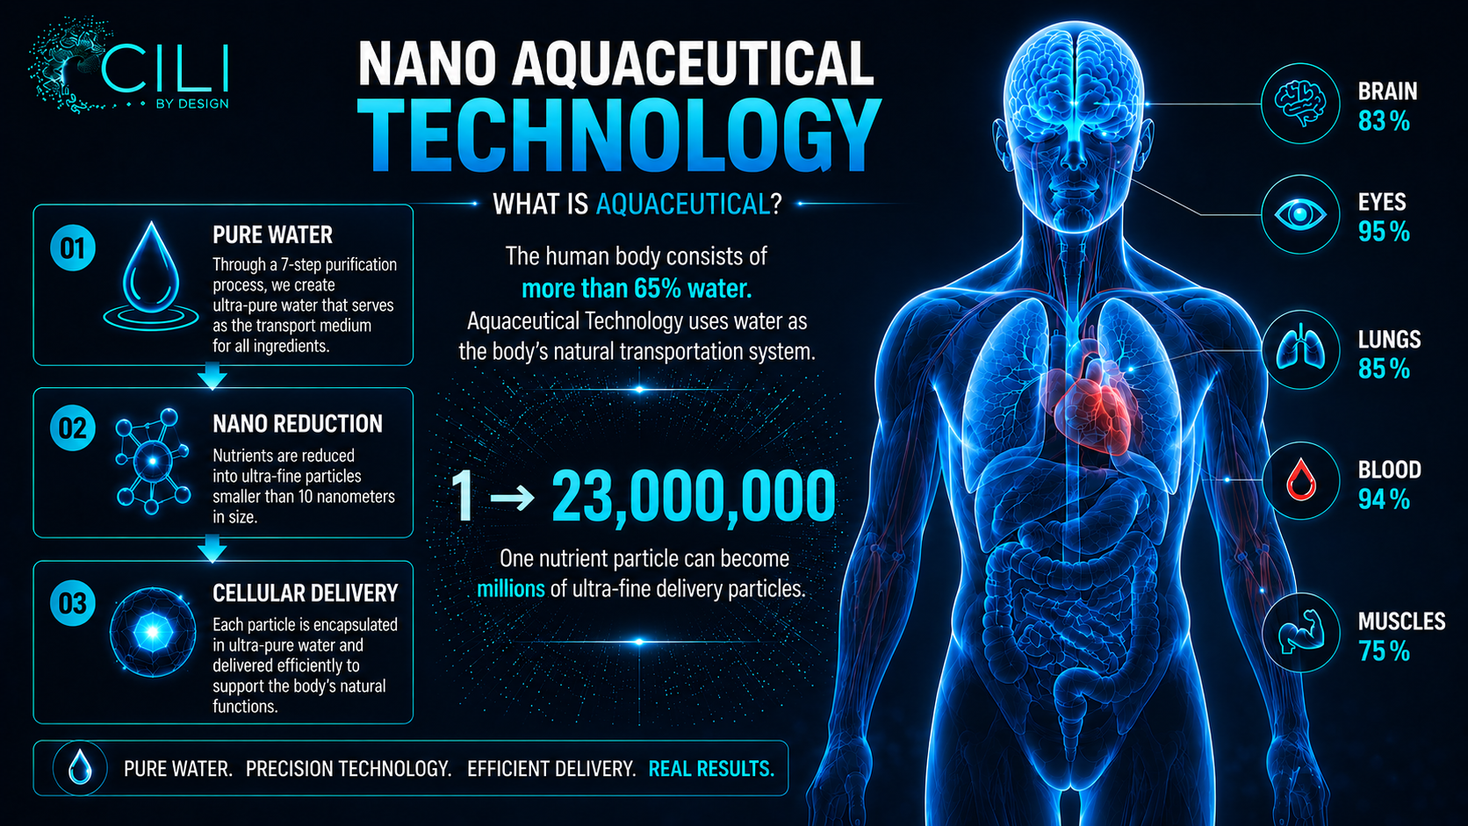
Notes:
To understand Aquaceutical Technology, we must first remember that the human body is made up of more than 65% water. Water is therefore the body's natural transportation system and plays a central role in delivering nutrients to the cells.
The technology is based on three key steps. First, the active ingredients are dissolved in pure, ultra-purified water. They then undergo a nano-reduction process, where the particles become extremely small. In fact, a single particle can be transformed into millions of ultra-fine delivery particles.
This small particle size creates a significantly larger surface area, which may improve the body's ability to absorb and distribute nutrients more effectively.
In the final step, the nutrients are delivered more efficiently to the body's cells, where they can support the body's natural functions. The goal is simple: to increase bioavailability and ensure that the body receives the maximum benefit from the active ingredients.

Slide 7
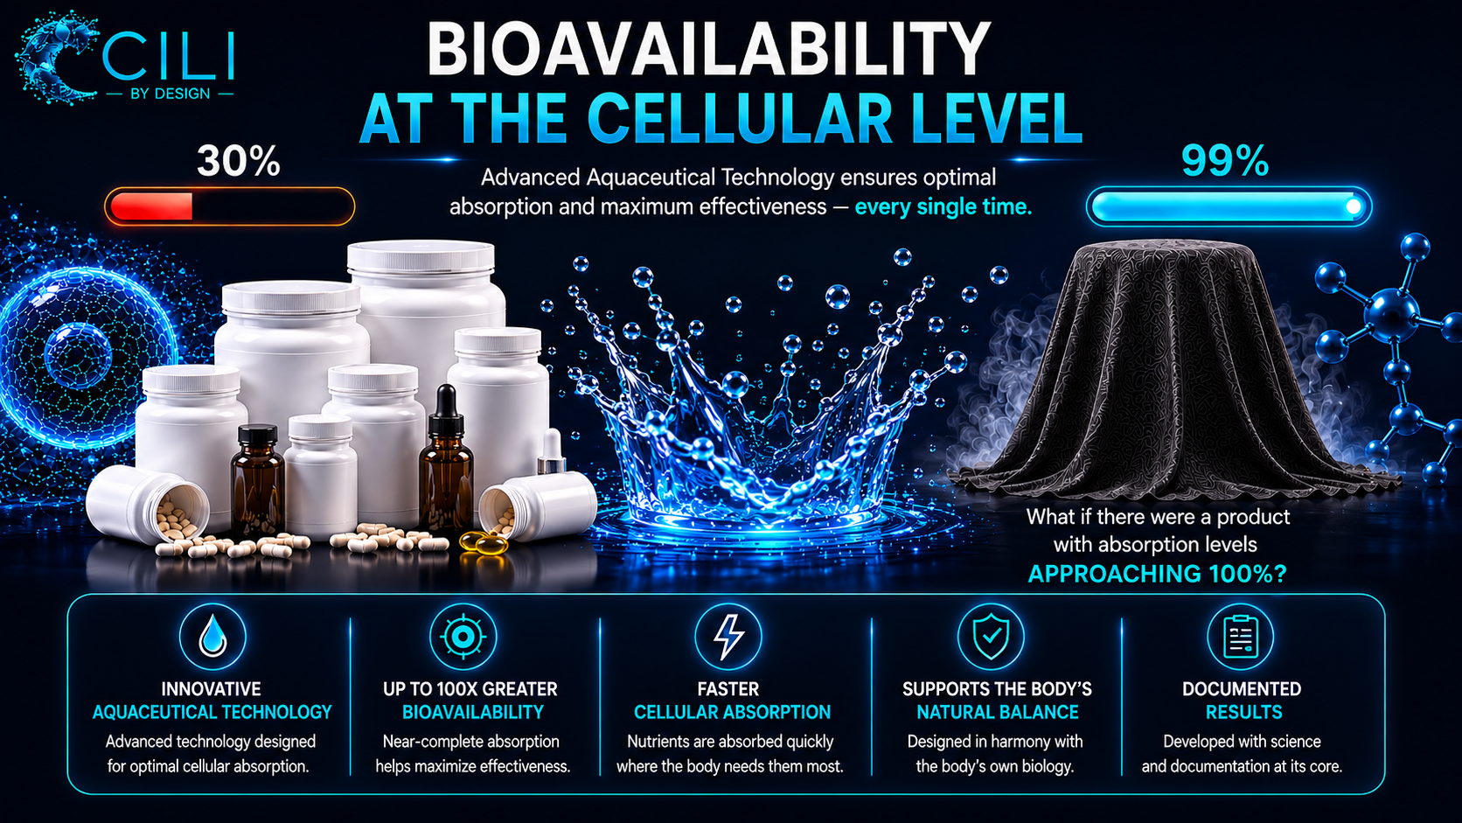
Notes:
“When we talk about nutritional supplements, it’s not only about what is in the product — it’s also about how much the body is actually able to absorb.
The first-generation products we know today are largely based on what is called primary delivery, where the body has to work to obtain the nutrients.
CILI works with Aquaceutical Technology, a development in advanced cellular nutrition. We therefore ask the question:
What if there were a product where bioavailability was approaching 100%?
That is exactly the thinking behind the technology — delivering nutrition more effectively, faster, and where the body can benefit from it the most.”

Slide 8
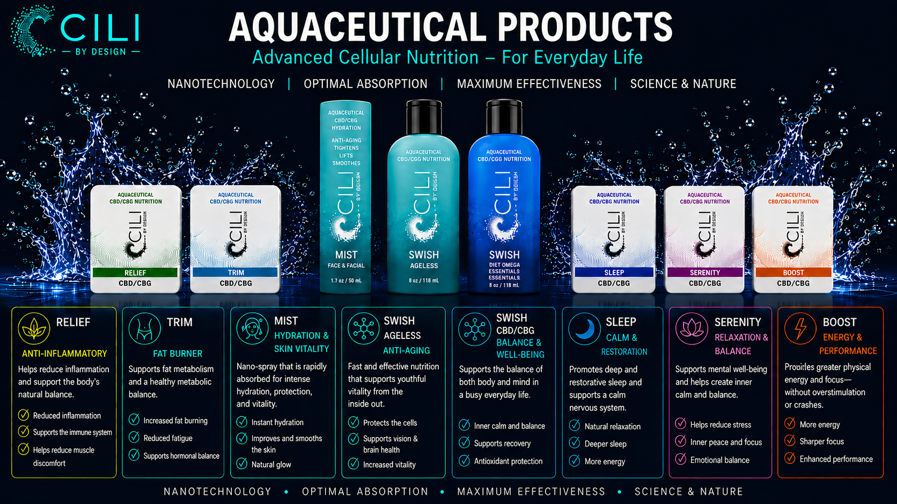
Notes:
"People don't buy products.
They buy results."
"Products are simply tools.
The real goal is a better quality of life.”
Go through the product-line from left to right.
Share the USP.

Slide 9
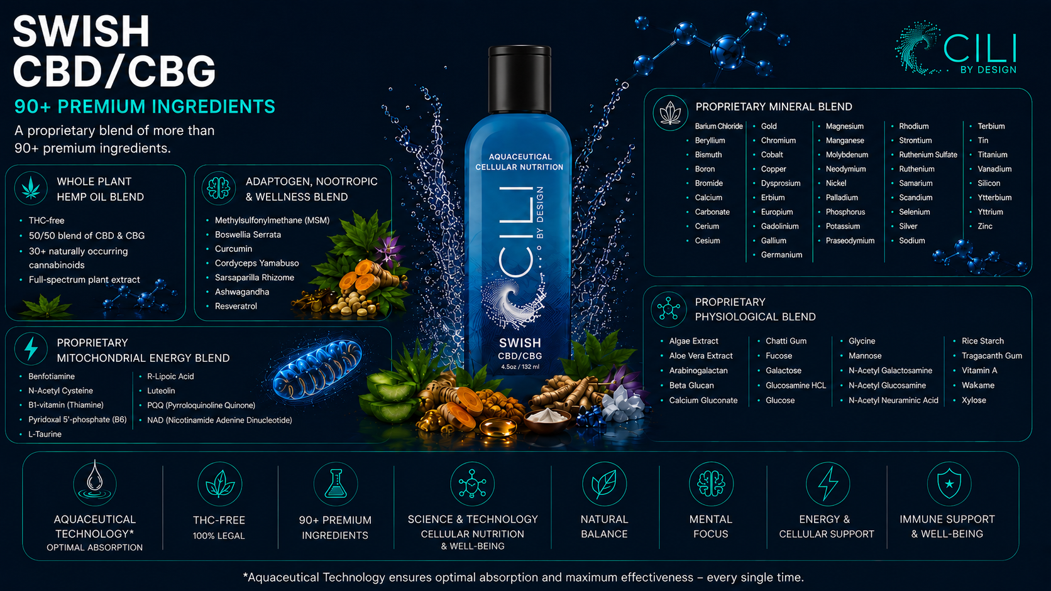
Notes:
90+ ingredients in Swish CBD/CBG

Slide 10
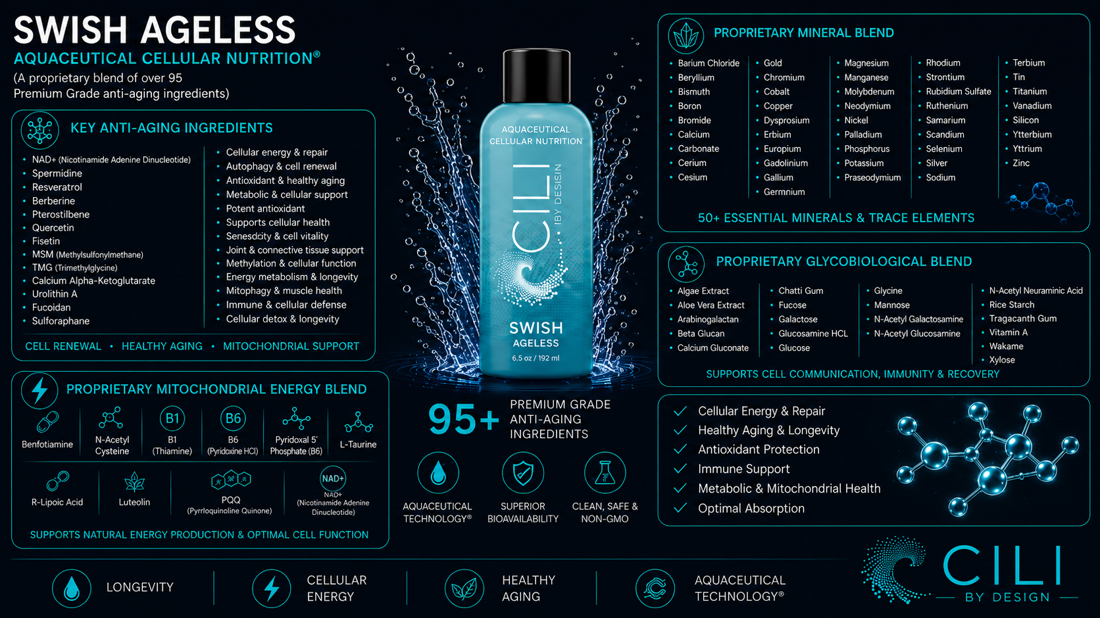
Notes:
95+ ingredients in Swish AGELESS

Slide 11
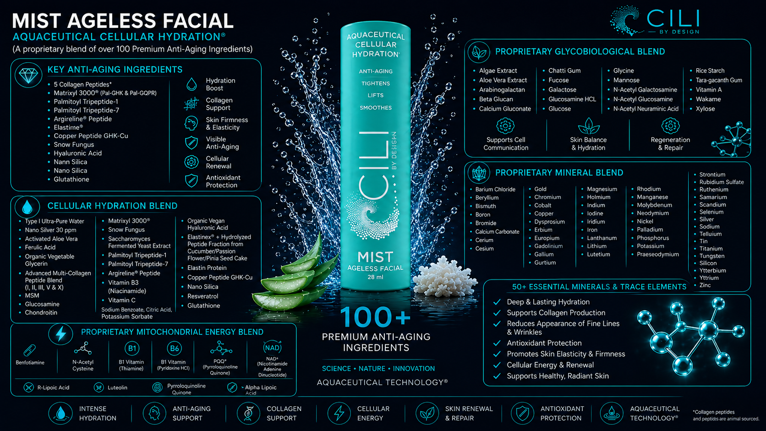
Notes:
100+ ingredients in MIST AGELESS

Slide 12
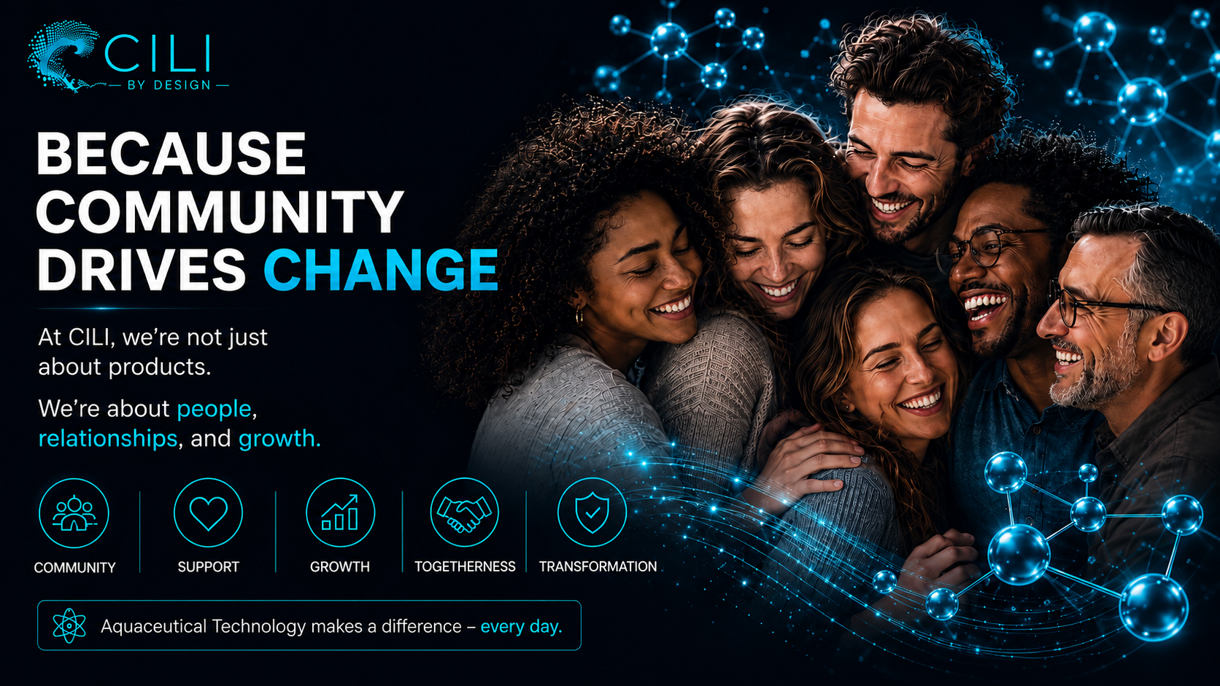
Notes:
CILI isn’t just about products – it’s about people, relationships and growth.

Slide 13
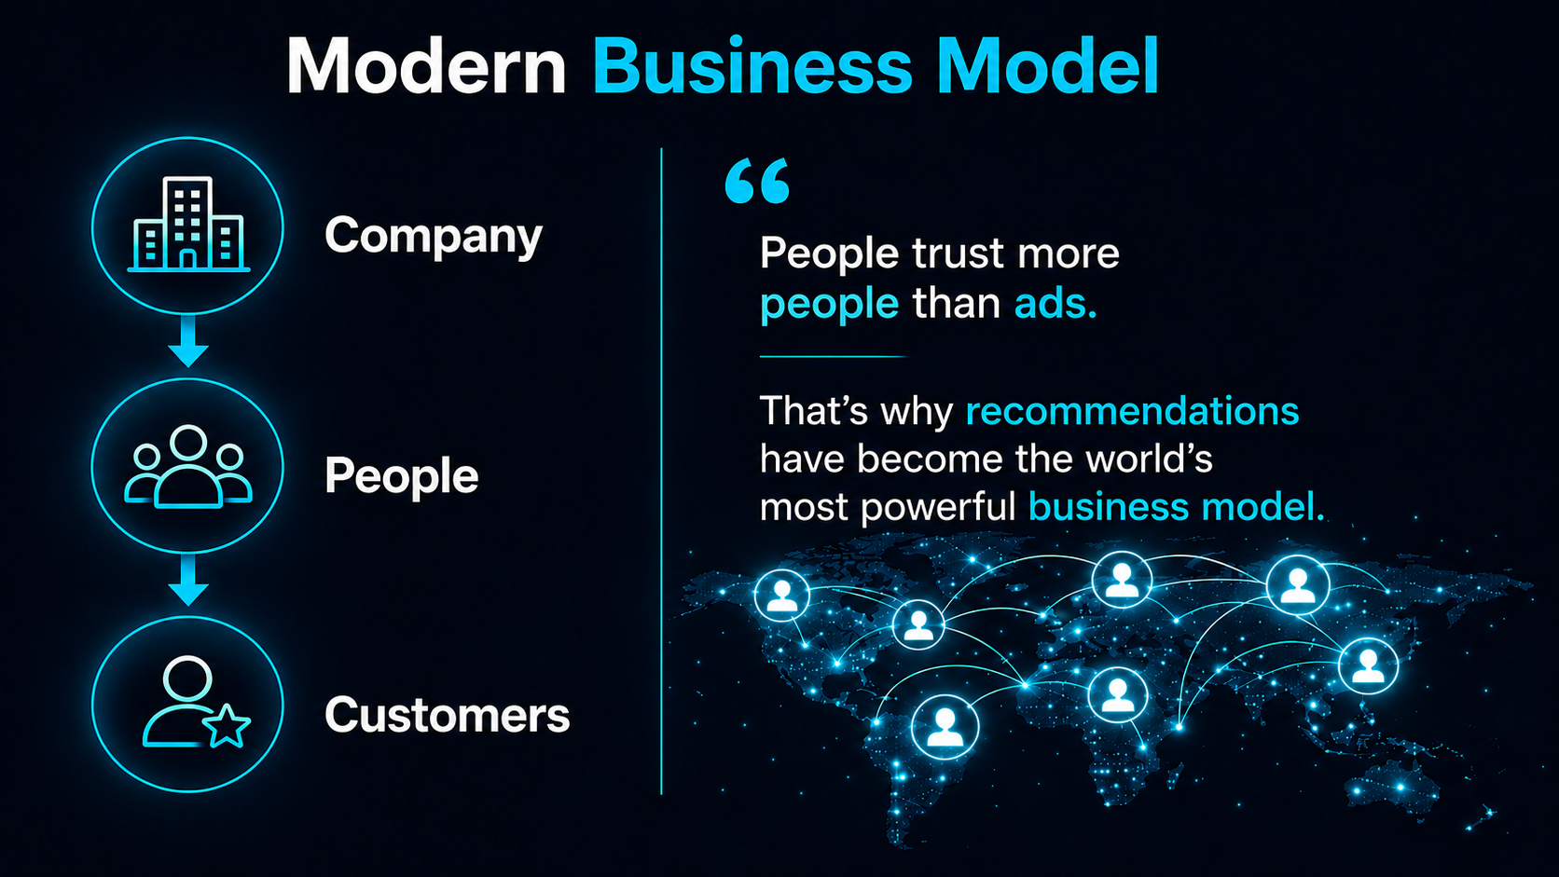
Notes:
"The world has changed, and the way businesses create growth has changed with it.
Previously, companies primarily reached customers through traditional marketing and advertising to large groups of people.
Today, recommendations have become one of the strongest ways to build trust in a world where people increasingly rely on recommendations from others.
Therefore, many companies have chosen to focus on the most powerful form of marketing: people.
Instead of communicating directly with customers, they share experiences and recommendations through relationships and networks.
When people have a positive experience, they naturally share it with others – creating both trust, value, and growth."**

Slide 14
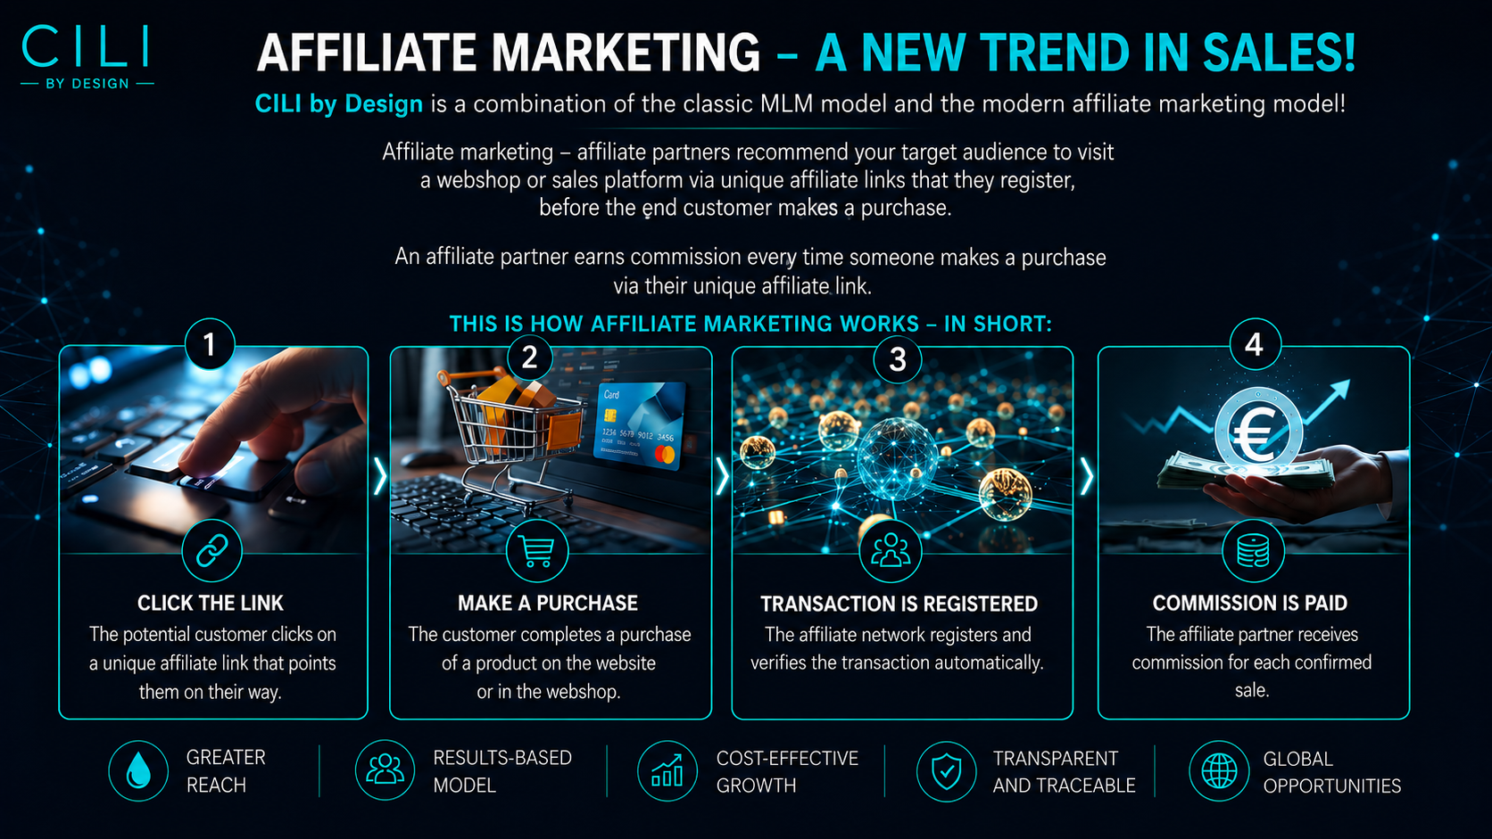
Notes:
Affiliate marketing is a modern way to generate sales through recommendations.
The basic principle is simple:
First, a person clicks on a unique link that is connected to the person who shared the recommendation.
If the customer chooses to purchase a product, the transaction is automatically recorded in the system.
Once the purchase has been completed and confirmed, a commission is paid to the person who referred the customer.
It is a model that companies love because they only pay for actual results—and it gives people the opportunity to earn income by sharing products and solutions they already believe in.
That is why affiliate marketing is now one of the fastest-growing trends in sales and online commerce.

Slide 15
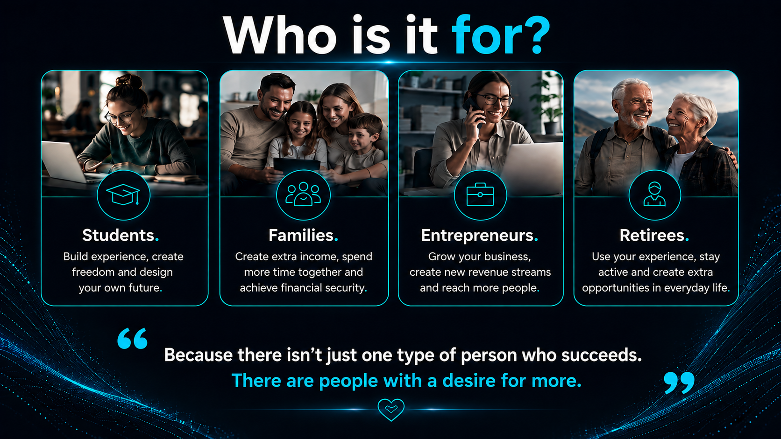
Notes:
One of the questions I’m often asked is: Who is this really for?
And the answer is simple — it’s not for one specific type of person.
We see students who want more freedom and experience.
Families who would like to create greater financial security.
Entrepreneurs and business owners who want more customers and additional income streams.
And retirees who want to stay active and create new opportunities.
What they all have in common is not their age, background, or experience.
What they have in common is a goal and a desire to create something more in their lives.

Slide 16
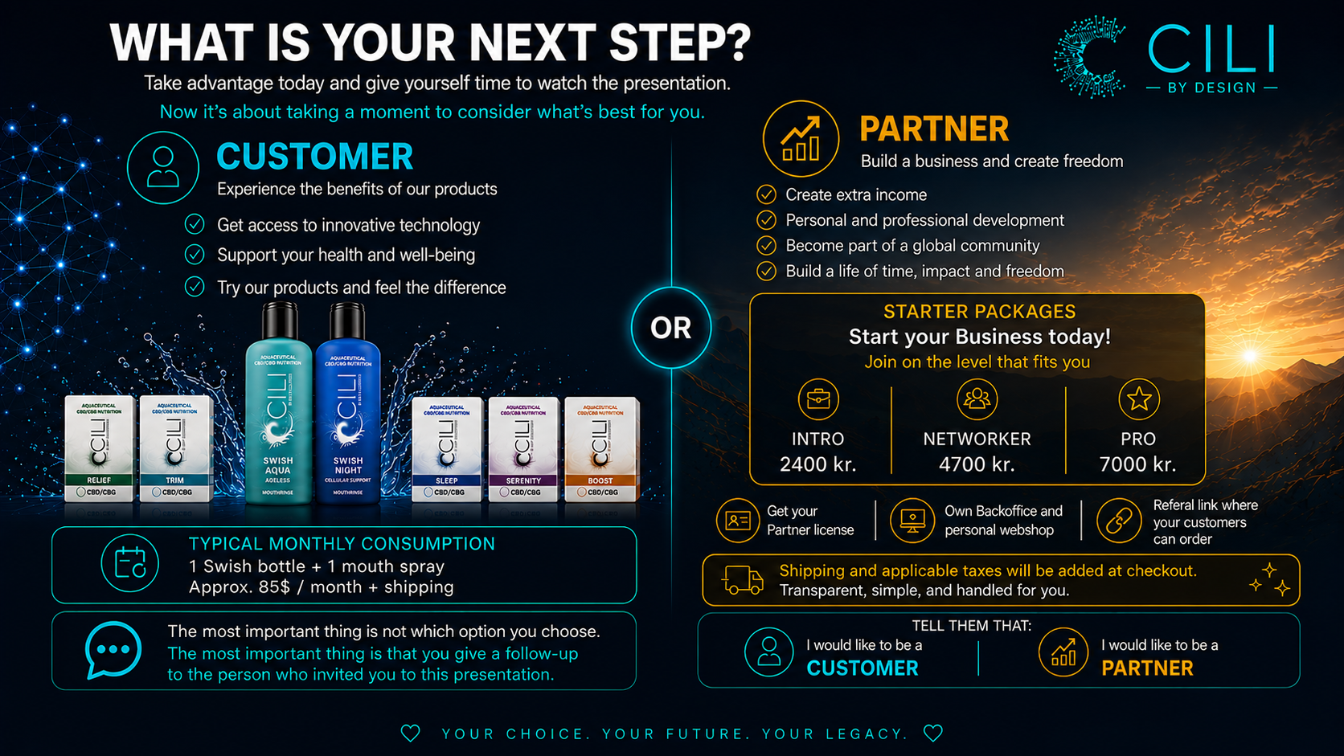

Slide 17


